Slide 1



Recruitment Dashboard
View in Power BI
Last data refresh:
12/4/2021 12:34:34 AM UTC
Downloaded at:
12/13/2021 10:47:19 PM UTC

Slide 2
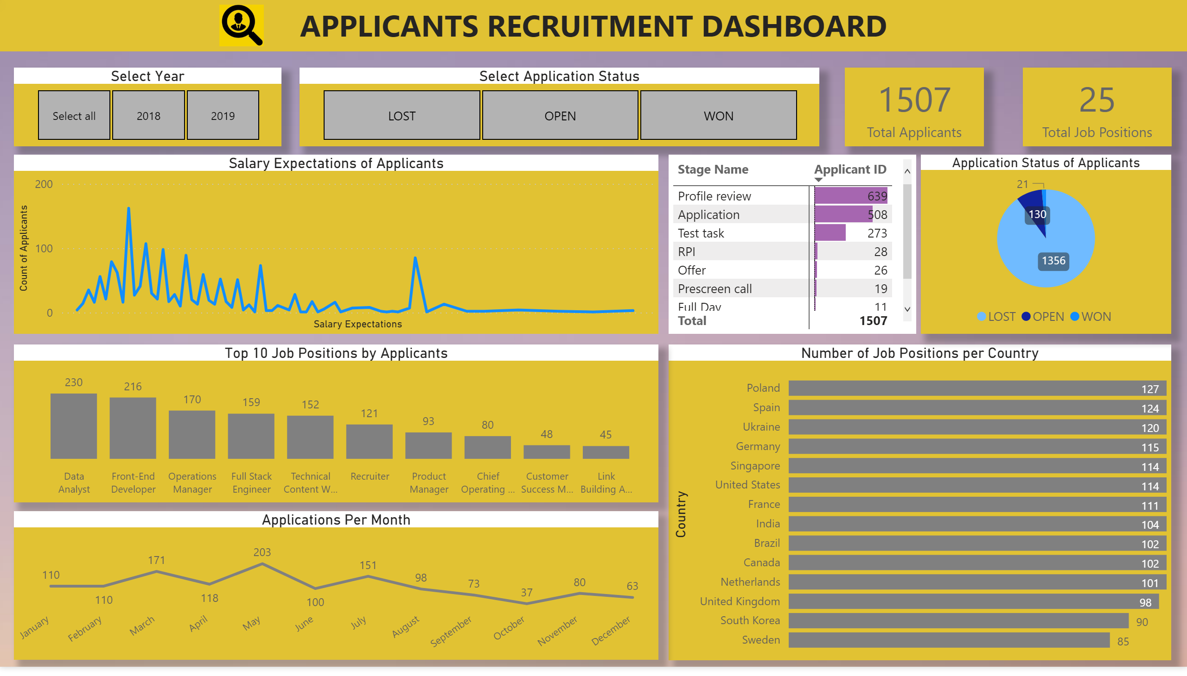
Page 1
Notes:
textbox
No alt text provided.
image
No alt text provided.
Select Year
No alt text provided.
card
No alt text provided.
Number of Job Positions per Country
No alt text provided.
Select Application Status
No alt text provided.
Top 10 Job Positions by Applicants
No alt text provided.
Applications Per Month
No alt text provided.
card
No alt text provided.
Salary Expectations of Applicants
No alt text provided.
pivotTable
No alt text provided.
Application Status of Applicants
No alt text provided.

